Slide 1
Using Cloud Computing Power to Accelerate Investigations
Abbott Data Analytics Symposium Oct 2018
David Shelley, Jessica Tower, Hassan Al-Atat
Advanced Algorithm Development

Slide 2
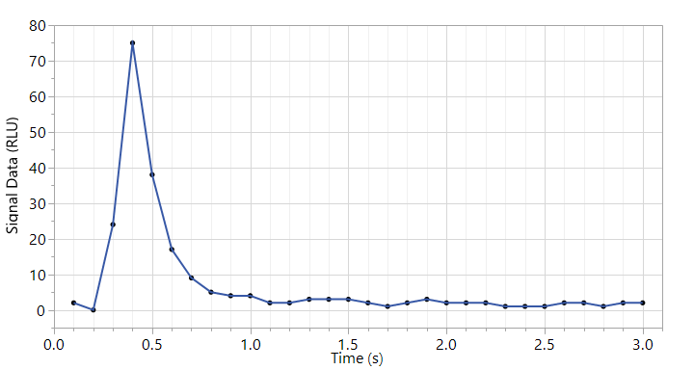
Summary Overview
Investigation initiated to search for a specific pattern in ARCHITECT optics subread profiles
Need to find every ARCH rep matching the pattern (low optics peak)
Date range included all data in the IDA (400 days)
Data size issues
400 days of ARCH Results table ~450gb
400 days of ARCH Subreads table ~350gb
Method comparison
On-Premises computing: local hardware and software (desktop computer, JMP Pro), local data source (Oracle servers)
Amazon Web Services (AWS) cloud computing: virtual hardware hosted on AWS servers, Apache Spark for parallel computing, Cloud data source
Typical Subreads
Looking for abnormal peak shape

Slide 3
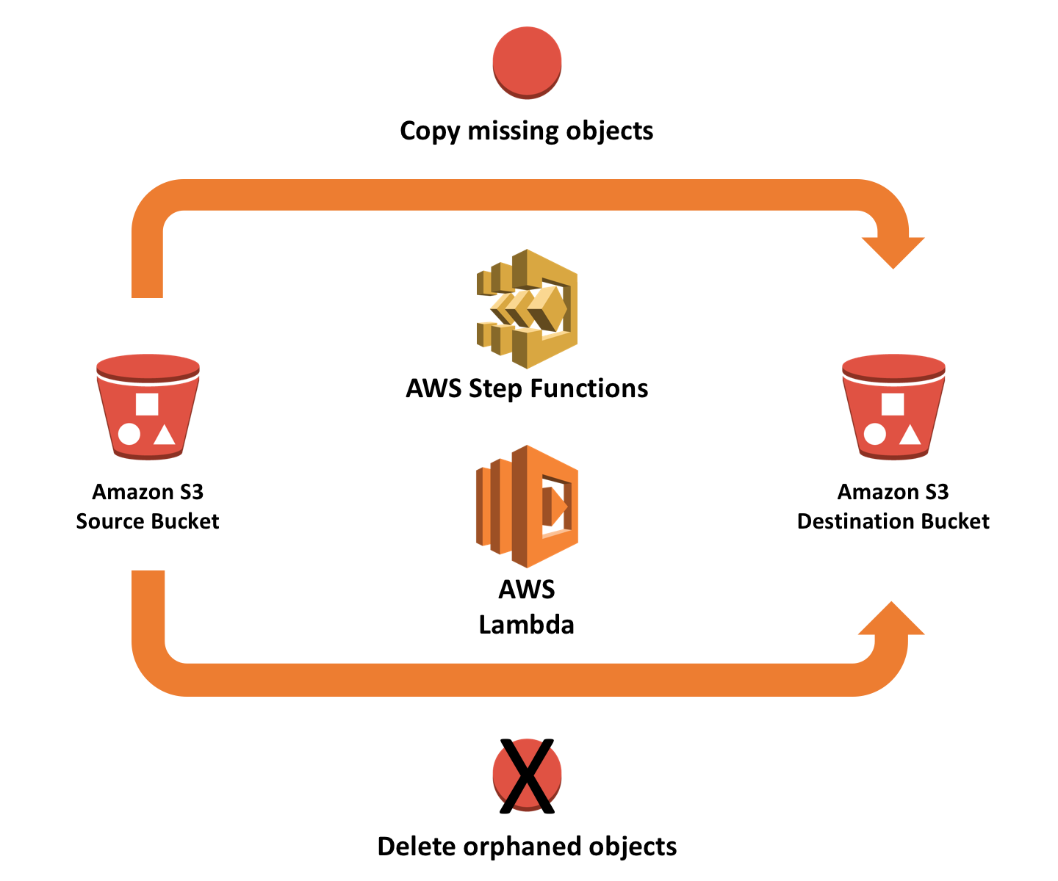
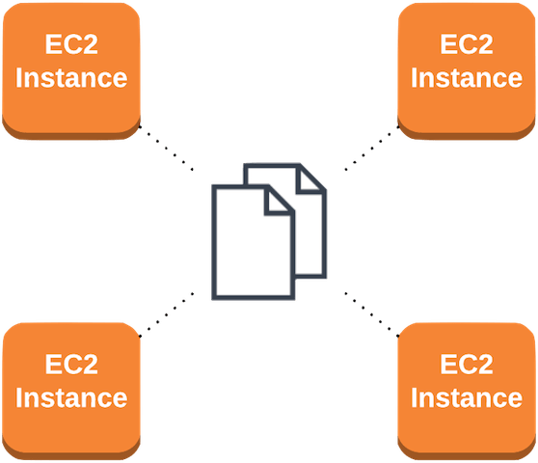
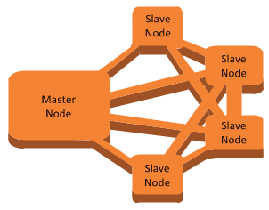
Amazon Web Services Background
Amazon Web Services (AWS) offers a wide variety of storage and computing applications on servers around the world
S3 (Simple Storage Service)
Data can be uploaded into buckets for short/med/long term storage
Think of these as hard drives in the cloud
EC2 (Elastic Cloud Compute)
A single virtual machine contained with an AWS server
Hardware can scale up as needed (CPUs and Memory)
Good for jobs that require more power but not distributed computing
EMR (Elastic MapReduce)
A cluster of EC2 instances with a master node and worker nodes
Cluster size can scale up for increased parallelization
Good for jobs that require distributed computing
EC2 Instance
S3 Bucket
EMR Cluster

Slide 4
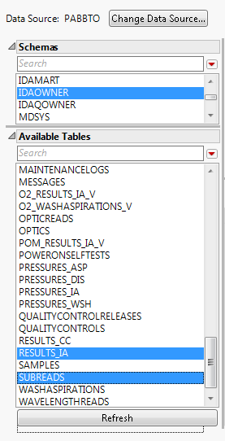
One Year of ARCHITECT Data
Cloud Analysis: IDA snapshot (May 2016 to May 2017)
Copy of the IDA transferred to AWS S3 (Amazon Web Services, Simple Storage Solution) by BDAA team
Tables stored as individual pipe-separated text files
Results table: 450gb, Subread table: 350gb
On-premises comparison: May 2017 to May 2018
Data queried from IDA/PABBTO
Similar sized Results and Subread tables

Slide 5

Workflow for Optics Algorithm
Results Table
Subreads Table
Query ARCH Results and Subreads tables from the IDA
Merge Results and Subreads tables
Calculate optics read ratios
Flag every rep that meets flagging criteria
Subset the flagged reps and write to an output table
Merged Table
Optics Check Algorithm
Flagged Results

Slide 6
On-Premises vs Cloud Use Case Comparison
 | Details | Strengths | Weaknesses | When to Use
Desktop Analysis | Working on your PC with JMP, R, Python to pull data, analyze, and write reports | Easy to use, more tools to work with; most software is designed to work at this level | Limited by PC memory, CPUs, physical space; not parallelized | Data size < 1/3 to 1/2 your memory
EC2 Instance | Single virtual machine on the cloud; accessed via remote desktop | Instance behaves like a desktop computer; scalable CPUs and RAM | Learning curve to set up correctly; some functions don’t work; not parallelized | Larger data set that you could process if your computer was more powerful
EMR Cluster | Cluster of EC2 instances generated for distributed computing | Highly scalable; can handle massive data quickly through parallel computing | Steep learning curve; requires different programming syntax within R | Large data sets

Slide 7

On-Premises Computing
Traditional method
Utilized JMP Pro
SQL Query of a local database (IDA/PABBTO) through ODBC connection
Performed table merge and algorithm calculation on local desktop
Flagged reps were written to output table
Due to size of tables, workflow had to be partitioned
Process was broken into monthly batches
Flagged results from each batch was merged into final output
ODBC query
Results
IDA/PABBTO
Local Hardware, JMP Pro

Slide 8





Cloud Methods: Software Selection
Apache Spark
Open source distributed cluster-computing program
Developed for big data and machine learning
Divides large jobs into smaller tasks to be completed in parallel
Available on EMR cluster software packages
Hive
Data warehouse software
Read/write/manipulate distributed data
R/RStudio Server
Acts as an interface for Spark
Dplyr library for data manipulation
Sparklyr library to communicate with Spark

Slide 9
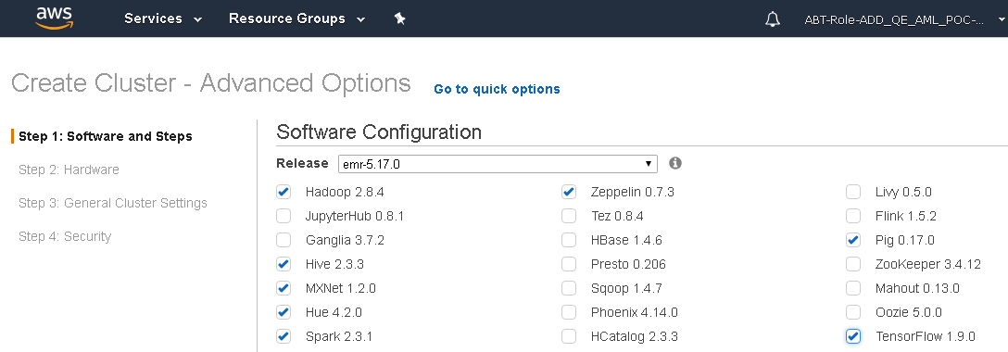
EMR Supported Software
EMR version is regularly updated to add new tools related to big data manipulation and analysis
Hadoop
Hive
Hue
Spark
MXNet
TensorFlow
Zeppelin

Slide 10
Cloud Methods: Data Preparation
Results and Subreads table for 400 days
Saved as two large pipe-separated files into S3 buckets
Data transferred to the cloud as part of an IDA snapshot by the BDAA team
Single pipe-separated files transferred from S3 storage to the Spark cluster
Files were distributed into Hadoop File system (HDFS) across worker node hard drives
Hive tables created to allow for data manipulation by Spark
Hive is a data warehouse software
Designed to read/write and manipulate large distributed datasets
Data transfer
Hive tables linked to HDFS data
Data distributed into HDFS

Slide 11
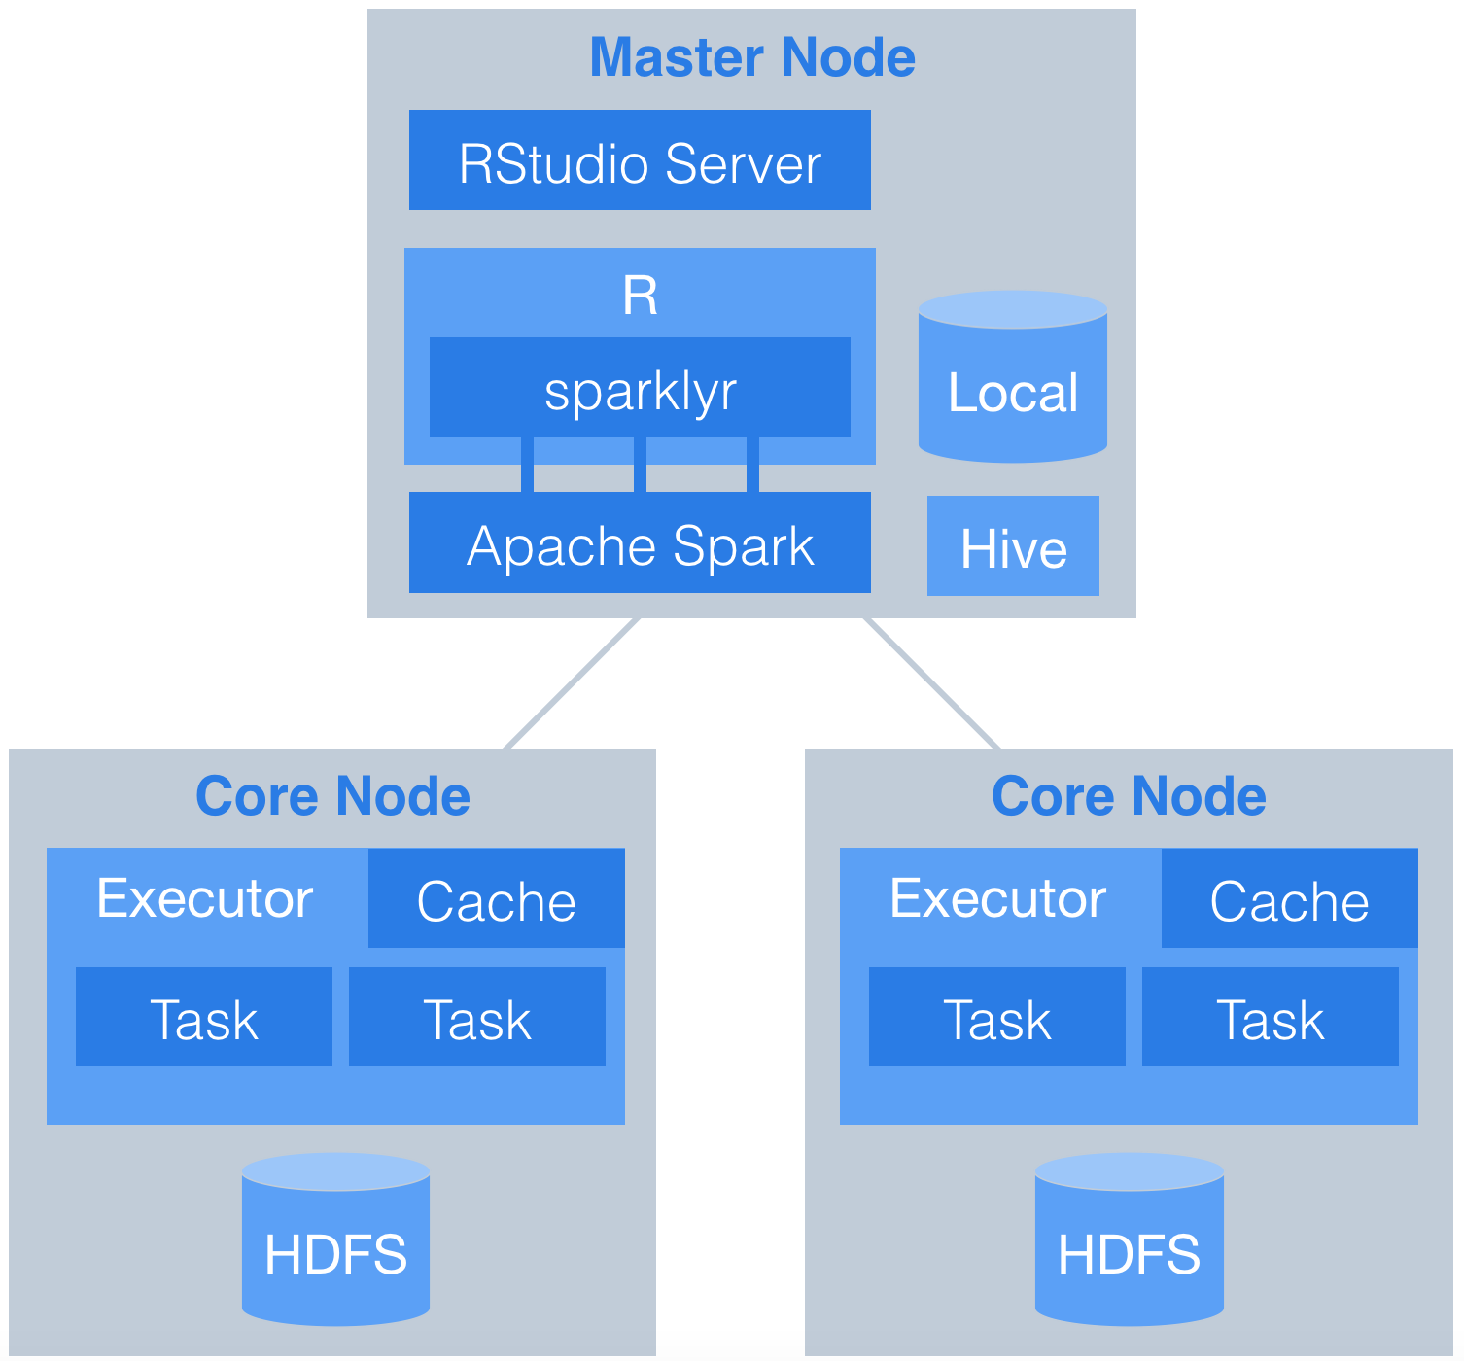
EMR Structure
Master node
Runs the cluster (scheduler); initial data prep happens here
R (sparklyr package) translates code to Spark SQL
Spark divides tasks to be sent to worker nodes
Worker (Core) Nodes
Heavy processing happens here
Tasks from the master node are run on small partitions called Executors within each worker node
Each Executor is assigned a portion of the total CPUs and memory
Completed tasks are sent back to the Master node

Slide 12
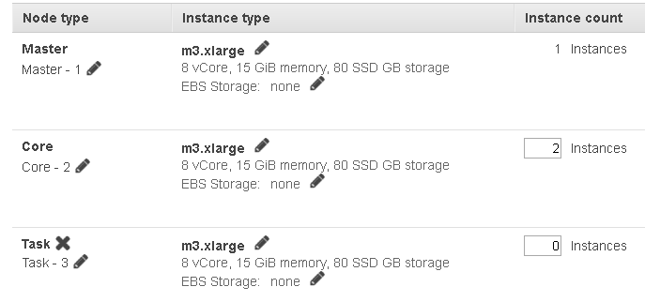
Cloud Methods: Hardware Selection
EMR Cluster
Fully customizable cluster dimensions on AWS
Hardware takes ~12 minutes to spin up once selections are made (plus ~15 minutes software installation)
Master Node
EC2 type sets the number of CPUs and amount of memory
Physical storage: need more than enough to transfer 800gb files into distributed file structure (HDFS)
Worker Nodes
Number of worker nodes
EC2 type sets number of CPUs and amount of memory
Amount of physical storage per node

Slide 13
Cloud Methods: Hardware Selection
EMR Cluster
Fully customizable cluster dimensions on AWS
Hardware takes ~12 minutes to spin up once selections are made (plus ~15 minutes software installation)
Master Node
EC2 type sets the number of CPUs and amount of memory
Physical storage: need more than enough to transfer 800gb files into distributed file structure (HDFS)
Worker Nodes
Number of worker nodes
EC2 type sets number of CPUs and amount of memory
Amount of physical storage per node
 | Master Node | Worker Nodes | Sum of Worker Nodes
Number of EC2 Instances | 1 | 5
EC2 Instance | R4.4xl 16 CPUs 122GB memory | R4.8xl 32 CPUs 244GB memory | 160 CPUs 1,220GB memory
Physical Storage | 1TB | 500GB | 2.5TB

Slide 14
Cloud Methods: Configuring Spark
Default configuration settings are not always optimal and can lead to wasted resources; additionally, Spark takes configuration settings as recommendations and can silently overwrite your decisions
Spark Executors
Partitioned resources within each worker node
Number of Executors can range from 1 to the number of CPUs per worker node; worker node memory is divided evenly between Executors
Default Parallelism is the number of Tasks each Executor can run at the same time
Resources for Spark Driver and Overhead
Not all resources can be applied to Executors
Spark requires CPUs and memory at the Worker level to run the OS and organize jobs; overhead memory is also required to handle data shuffling
Spark configuration
Hardware configuration
Master Node
Worker Node
CPUs: 32, Memory = 244gb
Executor 1
CPUs: 8
Memory: 60gb
Executor 2
CPUs: 8
Memory: 60gb
Worker Node
Worker Node
Task
Task
Task
Task
Worker Node
Worker Node
Worker Node
Executor 3
CPUs: 8
Memory: 60gb
Executor 4
CPUs: 8
Memory: 60gb
Task
Task
Task
Task
HDFS

Slide 15
Cloud Methods: Configuring Spark
Default configuration settings are not always optimal and can lead to wasted resources; additionally, Spark takes configuration settings as recommendations and can silently overwrite your decisions
Spark Executors
Partitioned resources within each worker node
Number of Executors can range from 1 to the number of CPUs per worker node; worker node memory is divided evenly between Executors
Default Parallelism is the number of Tasks each Executor can run at the same time
Resources for Spark Driver and Overhead
Not all resources can be applied to Executors
Spark requires CPUs and memory at the Worker level to run the OS and organize jobs; overhead memory is also required to handle data shuffling
Spark configuration
Hardware configuration
Master Node
Worker Node
CPUs: 32, Memory = 244gb
Executor 1
CPUs: 32
Memory: 240gb
Worker Node
Worker Node
Task
Task
Task
Task
Worker Node
Worker Node
Task
Task
Task
Task
Worker Node
Task
Task
Task
Task
Task
Task
Task
Task
Task
Task
Task
Task
HDFS

Slide 16
Cloud Methods: Configuring Spark
Default configuration settings are not always optimal and can lead to wasted resources; additionally, Spark takes configuration settings as recommendations and can silently overwrite your decisions
Spark Executors
Partitioned resources within each worker node
Number of Executors can range from 1 to the number of CPUs per worker node; worker node memory is divided evenly between Executors
Default Parallelism is the number of Tasks each Executor can run at the same time
Resources for Spark Driver and Overhead
Not all resources can be applied to Executors
Spark requires CPUs and memory at the Worker level to run the OS and organize jobs; overhead memory is also required to handle data shuffling
Spark configuration
Hardware configuration
Master Node
Worker Node
CPUs: 32, Memory = 244gb
…
Executor 1
CPUs: 1
Memory: 7gb
Executor 2
CPUs: 1
Memory: 7gb
Executor 3
CPUs: 1
Memory: 7gb
Task
Task
Task
Worker Node
Worker Node
Worker Node
Worker Node
Worker Node
Executor 30
CPUs: 1
Memory: 7gb
Executor 31
CPUs: 1
Memory: 7gb
Executor 32
CPUs: 1
Memory: 7gb
Task
Task
Task
HDFS

Slide 17
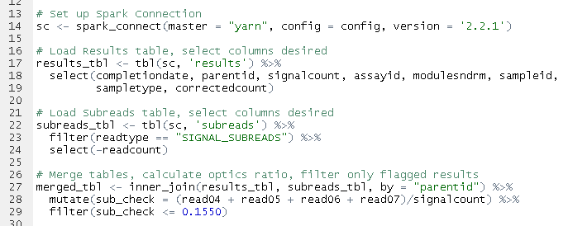
Spark Connection and Analysis in RStudio
Following hardware/software setup, algorithm can be run in just a few lines of R code
After connecting to the Spark cluster, load the two tables and merge them
Timing bottleneck is the table merge
Joining tables requires the matched data from each table to be on the same Executor
Data may have to be shuffled around to find a match among other Executors

Slide 18
Method Comparison
 | AWS Cloud Computing | On-Premises Computing
Resource Allocation | 30 minutes to select appropriate size of EMR cluster for the data, set up with required software | NA (hardware/software already in place)
Data Preparation | 2 Hours transferring two pipe-separated files into Hadoop, creating Hive Tables | NA (data on-prem)
Processing Time | 45 minutes for final algorithm | 20 hours for total processing time (query + algorithm + results out)

Slide 19
Summary and Future Directions
Benchmarked an On-Premises vs Cloud solution to aid an investigation into ARCH optics profiles
Cloud solution was significantly faster; hardware scale-up or down to the size of the problem
Some overhead spent figuring out the right hardware and configuration settings for the job and trying to address any bottlenecks in processing time
Data preparation has added complexity over On-Premises methods
Current and Future work
Machine learning applications (Tensorflow, h2o, SparkML) for pro-active maintenance modeling
Automated report generation on real-time data
Analyze large data sources without desktop limitations (e.g. Alinity PM or solenoid current data)

